Slide 1
COMMENT TOXICITY PREDICTION USING RNN
Batch No: 14 Dr.A.Kousar Nikhath
Associate Professor CSE-AIML & IOT 1. B. MOKSHAGNA 21071A6606
2.B. NAVANEETH 21071A6611
3. C .SAI SREEJA 21071A6615
4. G. RUCHITHA 21071A6620

Slide 2
Abstract
In today's digital era, online platforms such as YouTube, Instagram, and various social media channels have become integral parts of our daily lives, providing avenues for communication, expression, and interaction. However, with the proliferation of user-generated content, the "Issue of toxicity "in comments has emerged as a significant concern, posing challenges to maintaining a positive and safe online environment. In this study, we propose a Deep learning approach, leveraging "Sequential and Recurrent neural network (RNN)" models implemented using "TensorFlow" and "Keras" frameworks, to predict comment toxicity in Social media comments. By harnessing the power of deep learning, our model aims to accurately classify comments based on their toxicity levels, thereby enabling platforms to proactively identify and mitigate potentially harmful content .By avoiding straightforward algorithms such as linear regression or classification, we showcase the effectiveness of our approach in fostering a safer online environment. Through extensive experimentation and evaluation, we demonstrate the effectiveness and robustness of our approach in achieving high accuracy and reliability in comment toxicity prediction. Our project underscores the importance of leveraging advanced machine learning techniques to address real-world challenges in online content moderation, ultimately contributing to fostering healthier and safer digital communities.

Slide 3
Introduction:
These days , online platforms have become vital spaces for communication, information sharing, and community building. However, these platforms also face significant challenges, one of the most pressing being the proliferation of toxic comments. Toxic comments—those that are harmful, abusive, or hateful—can severely degrade the quality of online interactions, leading to hostile environments that deter positive engagement and suppress diverse voices.The project on Comment Toxicity Prediction aims to address this issue by leveraging machine learning techniques to automatically detect and classify toxic comments. The core objective is to build a predictive model that can accurately identify toxicity in user-generated content across various online platforms, such as social media, forums, and comment sections of news websites.

Slide 4

Literature Survey
https://docs.google.com/document/d/1WCoR0o5Bn3nqsOsthNjl2rVPCd4qAyyi/edit

Slide 5
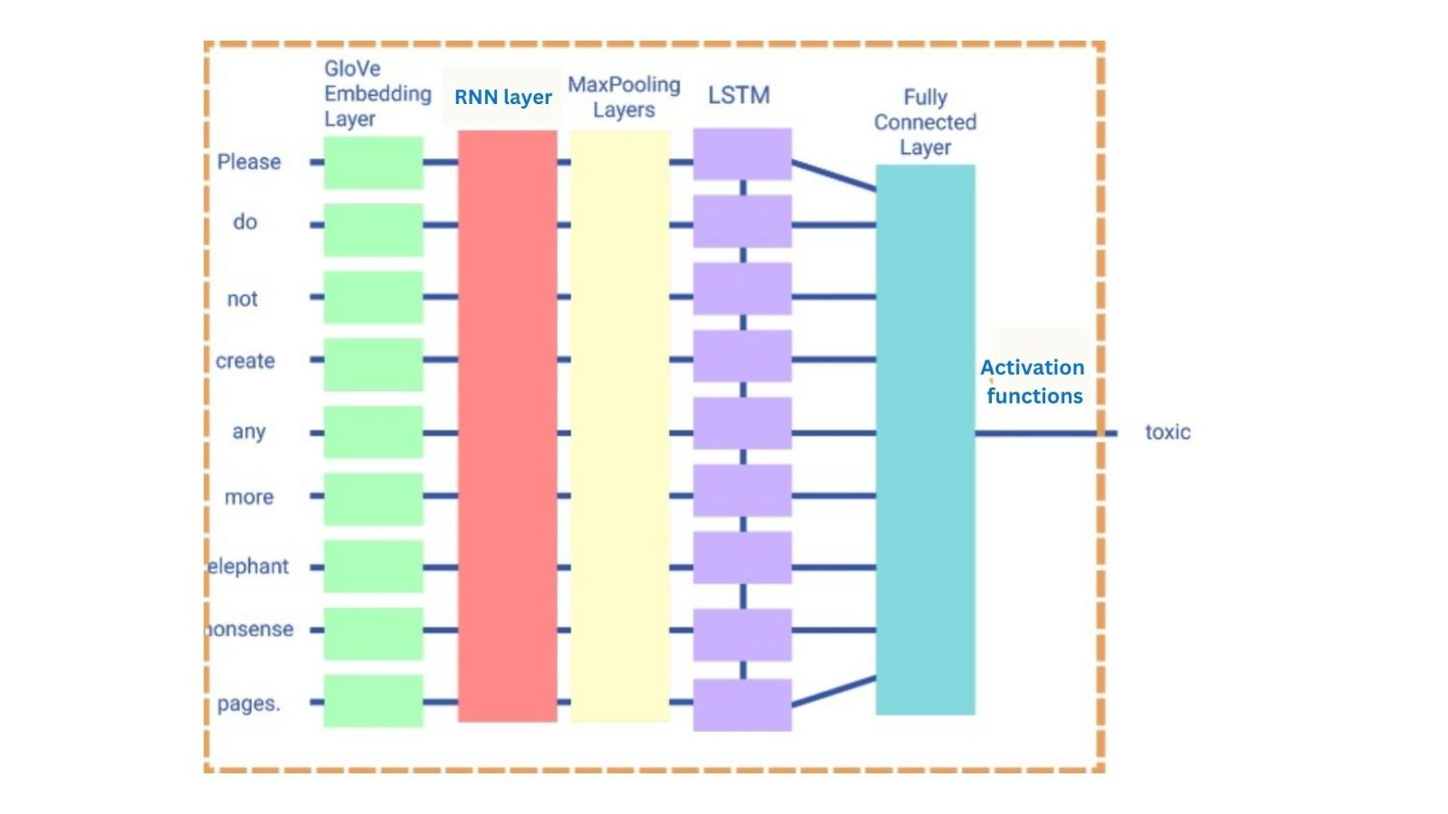
System architechture

Slide 6
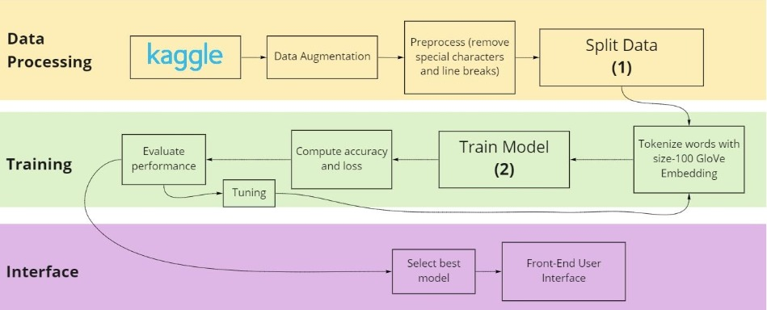
Dataflow diagram

Slide 7
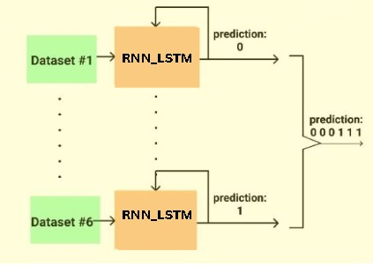
RNN_LSTM WORK FLOW:

Slide 8
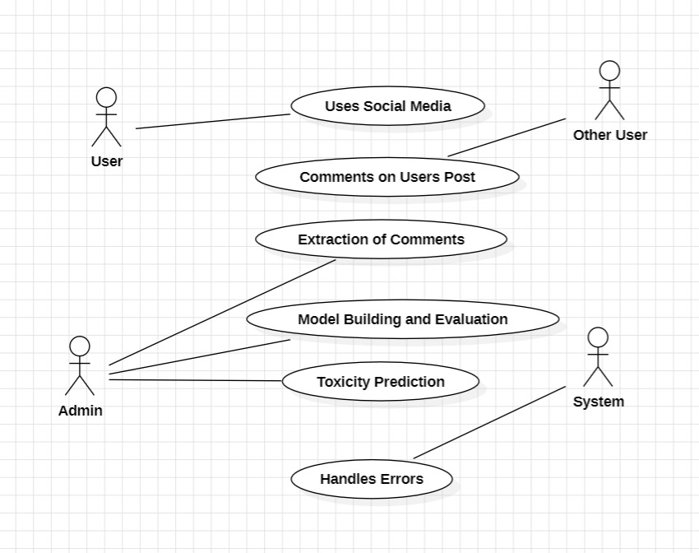
Use Case Diagram

Slide 9
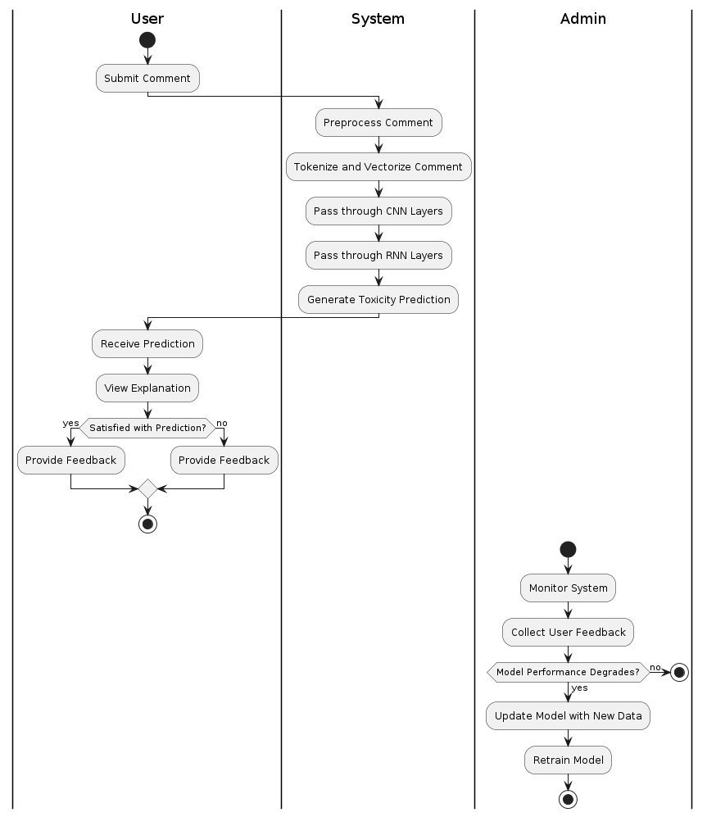
Activity Diagram

Slide 10
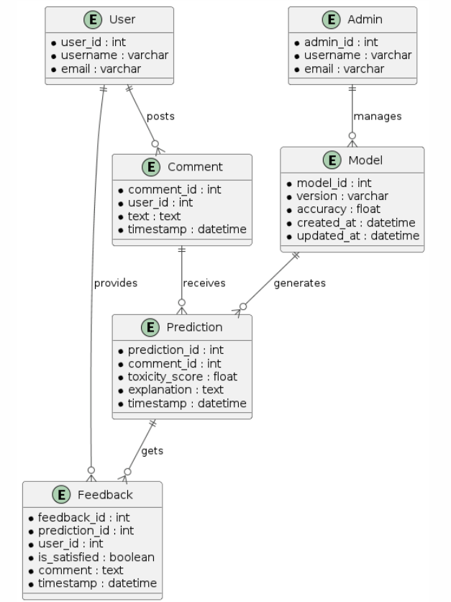
ER Diagram

Slide 11
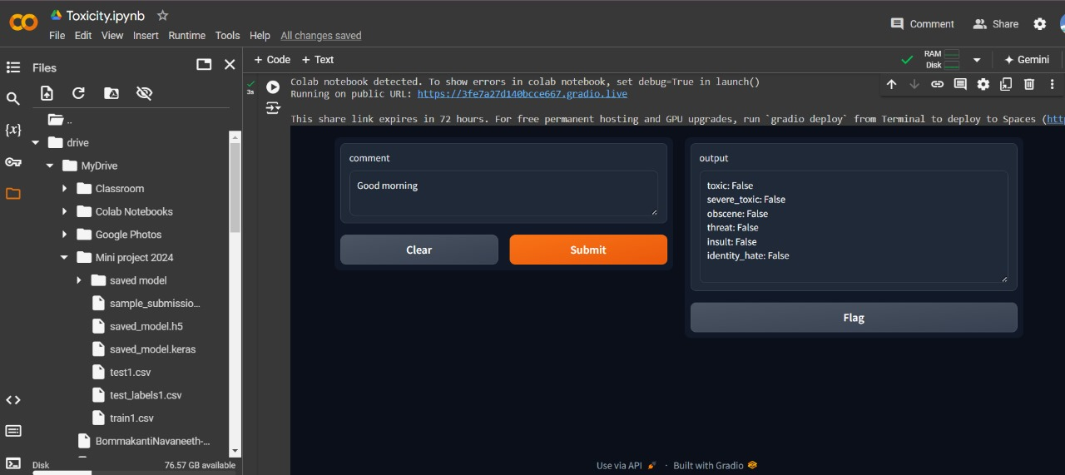
Final Result :

Slide 12
Requirement Verification
Functional Requirements
Non Functional Requirements
_{Data Collection}
_{Data Preprocessing}
_{Model Architecture}
_{Training}
_{Model Evaluation}
_{Input and Output}
_{User Feedback}
_{Monitoring}
_{Maintenance}
Response Time
Scalability
Data Security
Performance
Usability
Fault Tolerance

Slide 13
Security Considerations:
Data Security
Data Privacy: Ensure that the data used for training the model is anonymized to protect the identities of individuals whose comments are being analyzed.
Secure Storage: Store the training data, model, and prediction results securely to prevent unauthorized access or data breaches.
Access Control: Implement strict access controls and authentication mechanisms to restrict who can access the data and the model.
User Privacy
Minimize Data Collection: Collect only the necessary amount of data required for the model to function, minimizing the risk of privacy invasion.
Encryption: Use encryption for data in transit and at rest to protect user comments and prediction results from being intercepted or accessed by unauthorized parties.
Model Robustness:
Regular Updates: Continuously update the model to address new forms of toxic language and emerging threats.

Slide 14
Technology Stack
Data Storage- SQL / MONGO DB Database
Data Preprocessing-Pandas, Numpy, SpaCy, TensorFlow
Model Architecture-Sequential RNN
Model Training- Google Colab
Model Evaluation-Sklearn
FrontEnd UI - Gradio

Slide 15

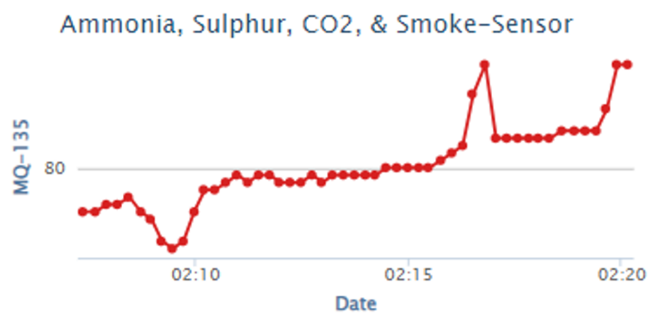







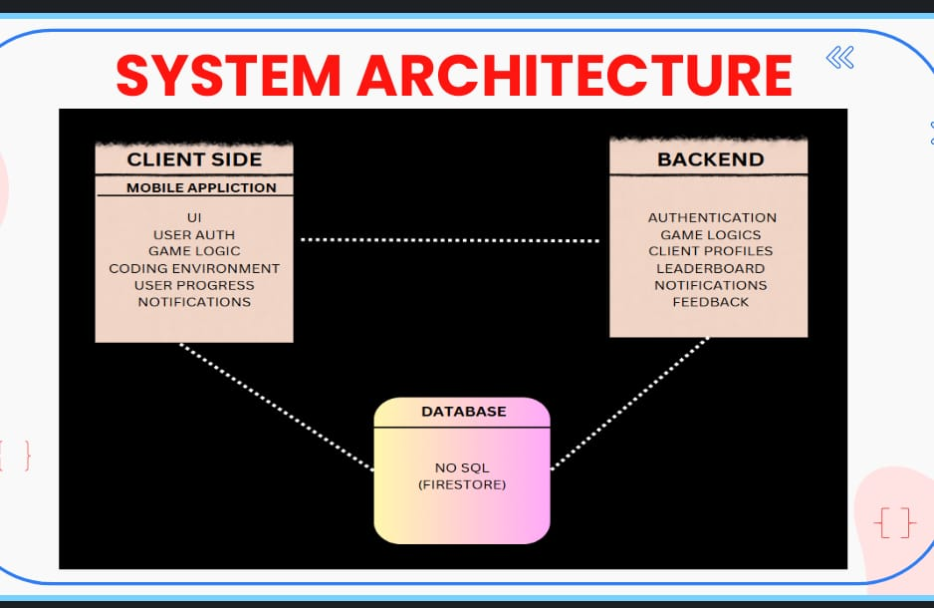
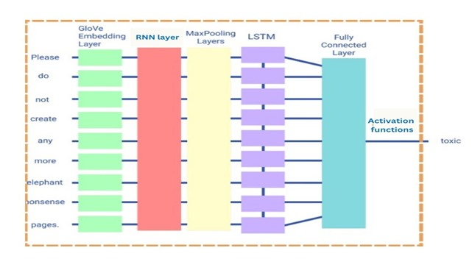
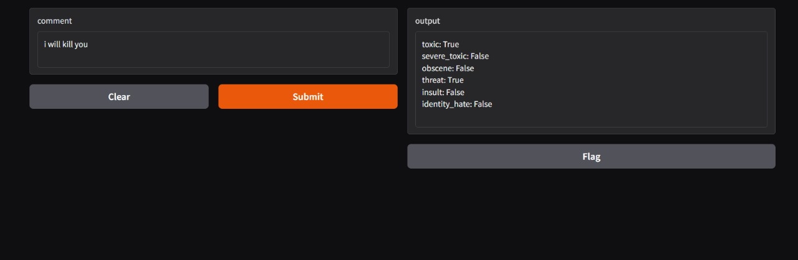
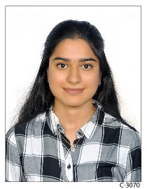
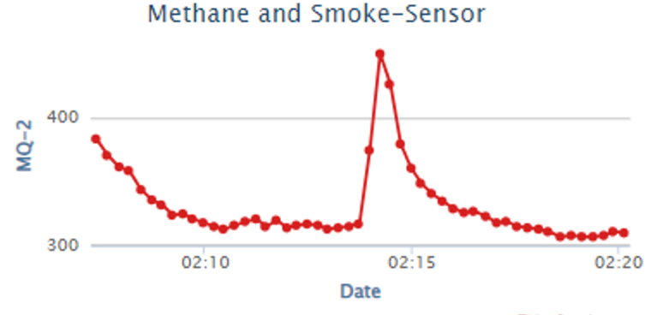



An Autonomous Institution, NAAC A++ Grade, NBA Accredited
DEPARTMENT OF COMPUTER SCIENCE & ENGINEERING (AIML & IOT)
Creating Societal Impact as Students of CSE IoT Through B.Tech Project
Comment Toxicity Prediction-RNN Model that predicts toxicity in social media Comments .
Social media comment toxicity prediction uses LSTM-based RNNs to identify harmful language and ensure safe interactions. Preprocessed comments are tokenized and converted into embeddings for input. LSTMs handle complex sentence structures, providing toxicity scores or classifications to aid moderation.
OUR MODEL RESULTS
OUR TEAM
SYSTEM ARCHITECTURE
B.Mokshagna
C.Sai sreeja
Guide:
Dr.A.Kousar Nikhath
Social media platforms often face the challenge of toxic comments that harm online interactions. Toxicity prediction aims to detect and address such harmful language automatically. This process uses machine learning to analyze text data and flag inappropriate content. It helps maintain respectful communication in online communities. The approach reduces the need for manual moderation and ensures quicker responses to toxicity.
B.Navaneeth
G.Ruchitha
Toxicity prediction is a valuable tool for maintaining respectful and safe online environments. By automating the detection of harmful language, it reduces the burden on human moderators and enables faster responses. Advanced models like LSTMs enhance accuracy by understanding the context of comments. This approach fosters healthier online interactions and promotes positive digital communities.

Slide 16
Thank you
.

